Slide 1
Code Review Training Course.
Part 6a:
Taint Tracking
Static Detection of Second-Order Vulnerabilities in Web Applications
For VIB only
namhabach@gmail.com

Slide 2
Outline
1
What's Taint Tracking?
2
RIPS: Test cases & Limitations
3
What's second-order attacks?
4
Vital Point
5
How to detect Second-Order Vulnerabilities

Slide 3
What's Taint Tracking?

Slide 4
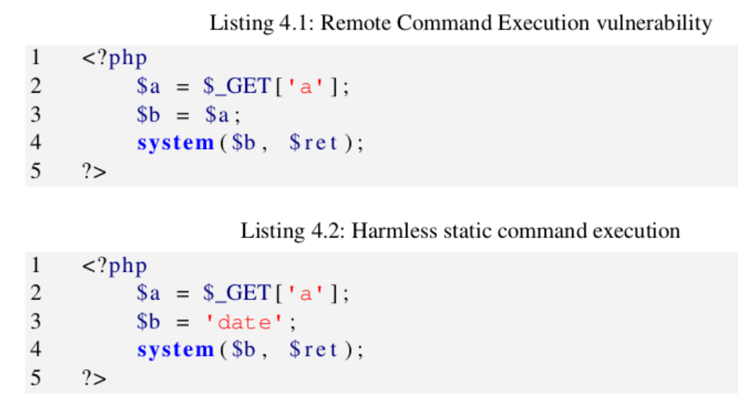
What's Taint Tracking?

Slide 5
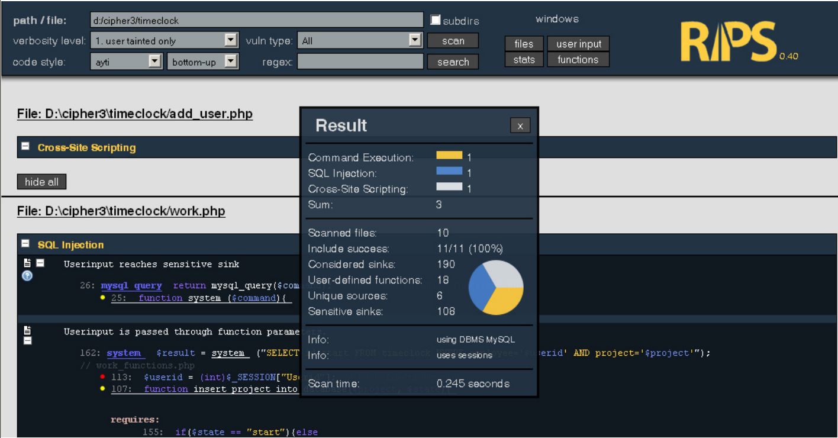
RIPS

Slide 6
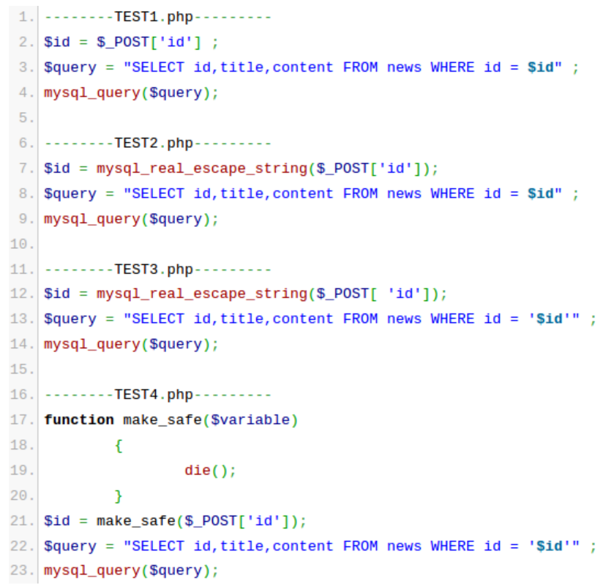
RIPS: Test cases

Slide 7
RIPS: Test cases
False Positive
VS
False Negative

Slide 8
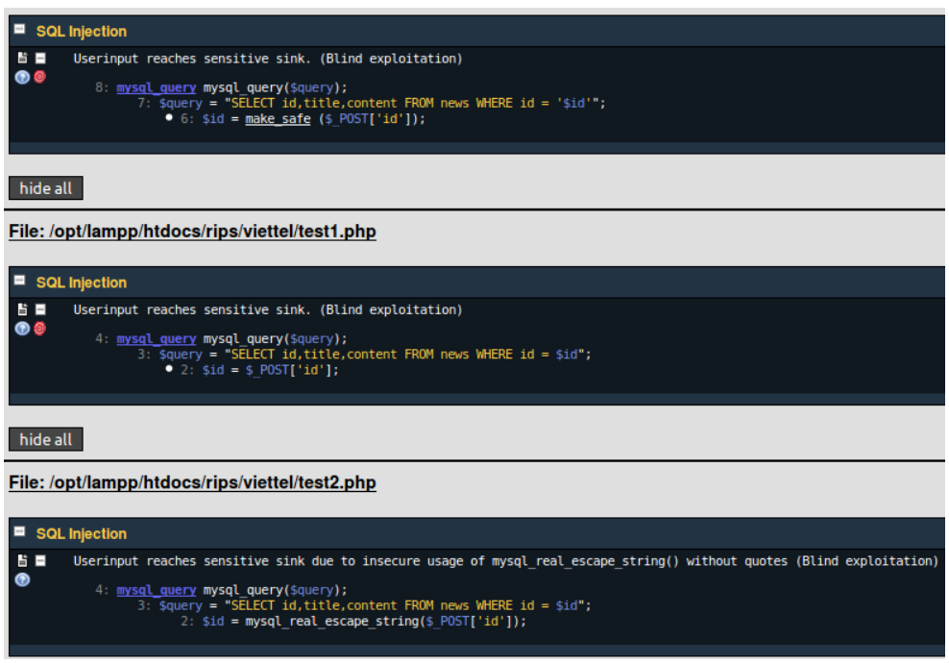
RIPS

Slide 9
Rips: Limitations
2nd order
…..

Slide 10
Static Detection of Second- Order Vulnerabilities in Web Applications

Slide 11
What's second-order attacks?

Slide 12
Second-order attacks
Vital points: Persistent Data Stores
  1. Databases
  2. Session Data
  3. File Names
  4. Others

Slide 13
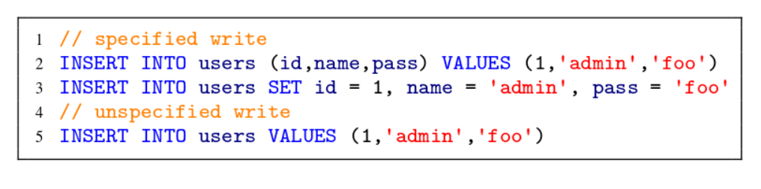
Second-order attacks
The first Vital Point:
  Databases

Slide 14
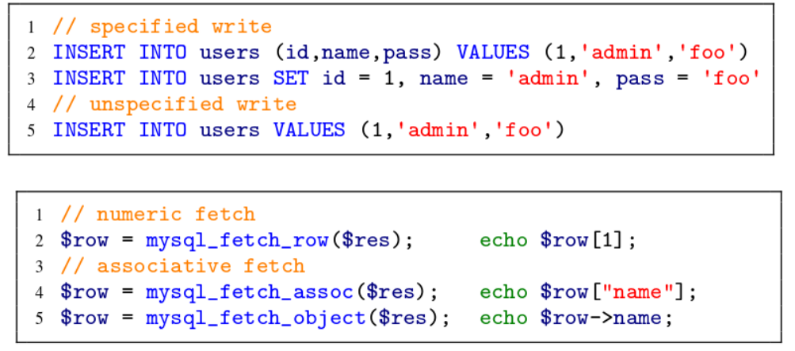
Second-order attacks
The first Vital Point:
  Databases

Slide 15
Second-order attacks
The 2nd Vital Point:
  Session Data
The 3nd Vital Point:
  Filename

Slide 16
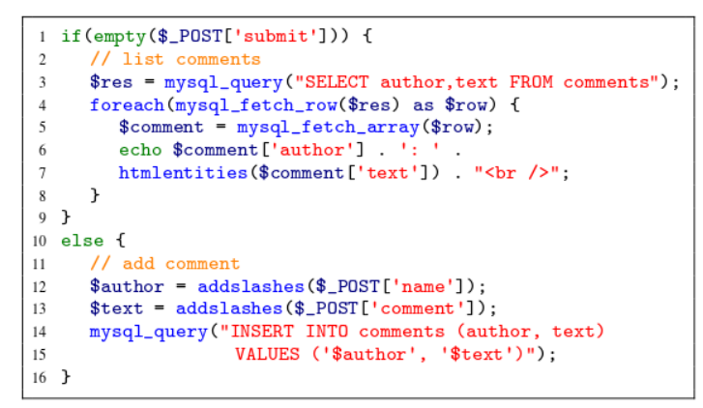
Second-order attacks
Persistent Cross-Site Scripting

Slide 17
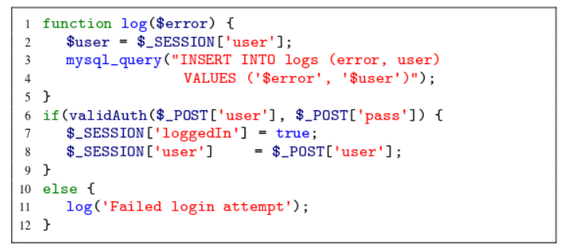
Second-order attacks
Second-Order SQL Injection

Slide 18
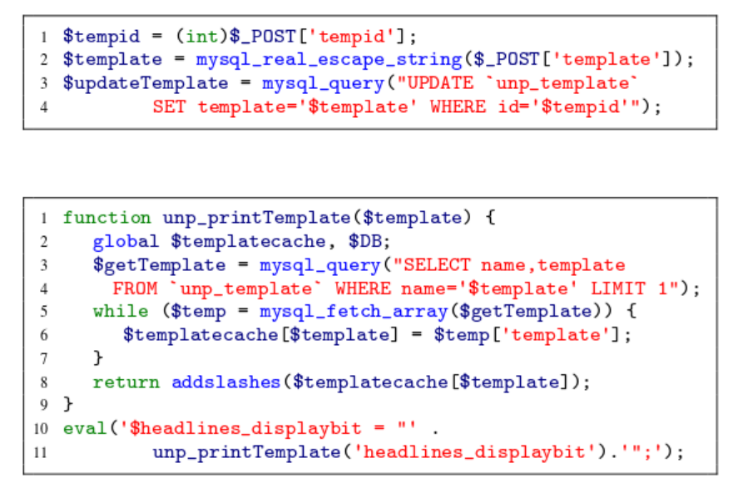
Second-order attacks
Second-Order RCE

Slide 19
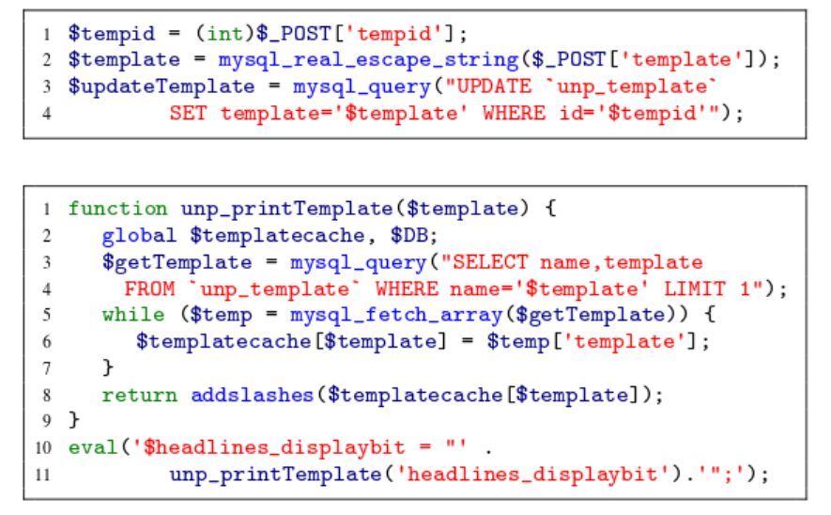
Second-order attacks
Second-Order RCE

Slide 20
How to detect Second-Order
Vulnerabilities

Slide 21
Questions?

Slide 22
#Enter to next part_>
End of Part 6a

